Slide 1
Representation Learning and its applications in Heterogeneous Networks
INFO-I606
Spring 2020
Arunav Saikia
M.S. Data Science arsaikia@iu.edu

Slide 2
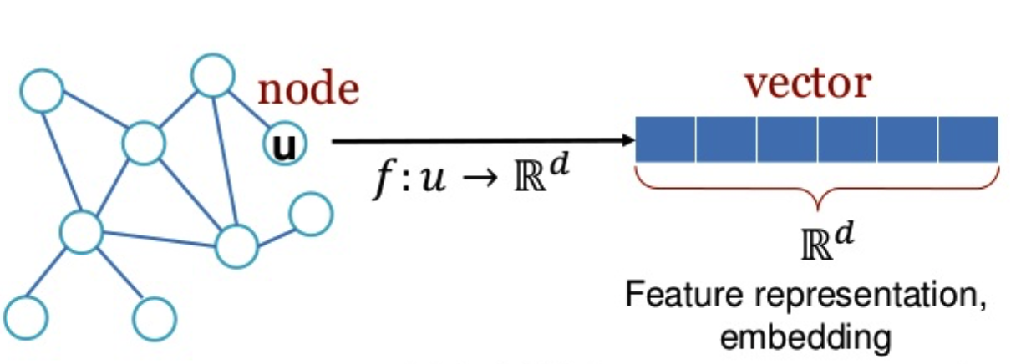
Motivation/Scope
Representation Learning aka Node embedding (d- dimensional latent representation)
Encode structurally and semantically similar nodes.
Node2vec, DeepWalk for embedding homogeneous graphs
Heterogeneous Networks – Bipartite (eg. Users and artists/songs they listen to)
Use embeddings for node classification/link prediction
Probe and compare the performance of different ML algorithms (linear/kernel based/tree based/ensembles)
ML models
Representation Learning on Networks, snap.stanford.edu/proj/embeddings-www, WWW 2018
https://open.spotify.com/playlist/37i9dQZF1DXaQ34lqGBfrU

Slide 3
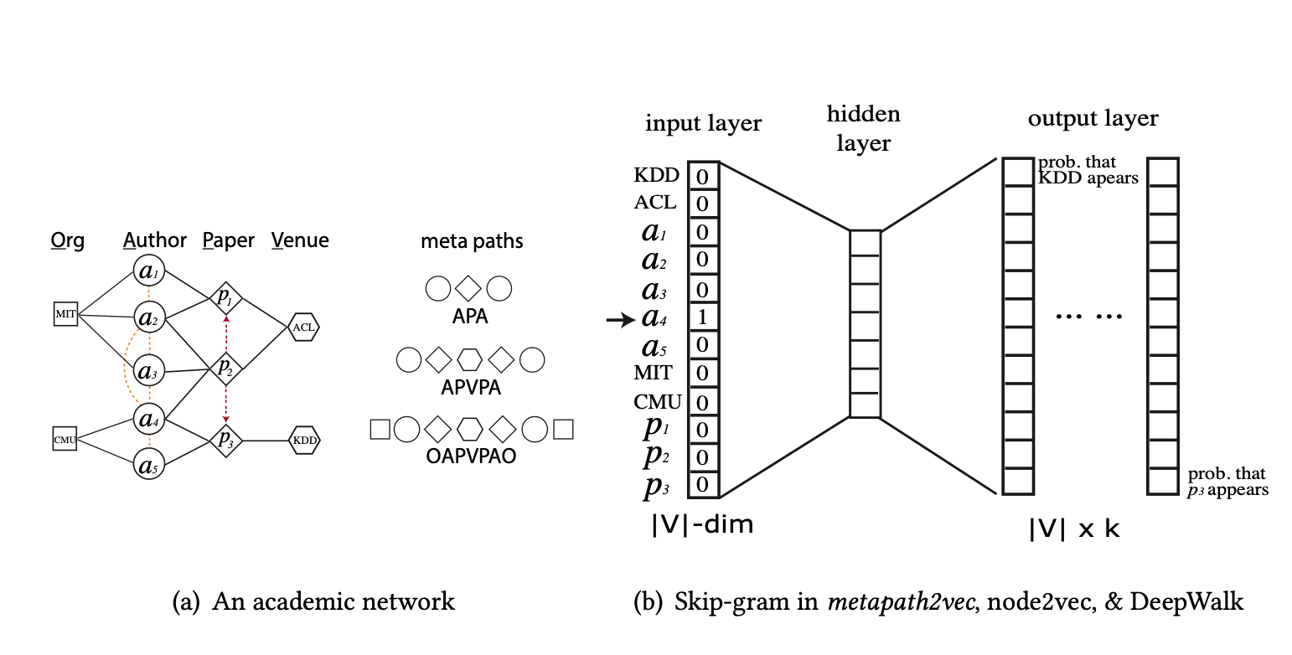
Data and Methods
This dataset has been obtained from Last.fm online music system.
Lastfm 2k dataset
1892 users listening to 17632 artists
11946 unique tags
Metapath2vec
A meta-path based representation learning technique for heterogenous graphs
Word2vec inspired skip-gram model to generate latent embeddings
http://ir.ii.uam.es/hetrec2011/datasets.html
https://ericdongyx.github.io/papers/KDD17-dong-chawla-swami-metapath2vec.pdf

Slide 4
User – Artist Interactions Network

Slide 5
User – User Friendship Network

Slide 6
Artist – Artist Influence Network

Slide 7
Metapath2vec Embedding
What is the right meta-path scheme?
Artist – User – Artist (AUA)
User – Artist – User (UAU)
User – Artist – Tag – Artist – User (UATAU)
Metapath hyperparameters- Walk Length (l) and Walks per node (n)
2 metapaths with AUA with l = 10 and n = [5, 10] – metapath generation takes exorbitant amount time
Skip gram hyperparameters – Embedding size (k) and Neighborhood size (d)
16 embeddings per metapath with k = [16, 32, 64, 128] and d = [3, 5, 7, 10] = 32 embeddings
Use embeddings for downstream task and gauge performance
Similarity Search
Clustering

Slide 8
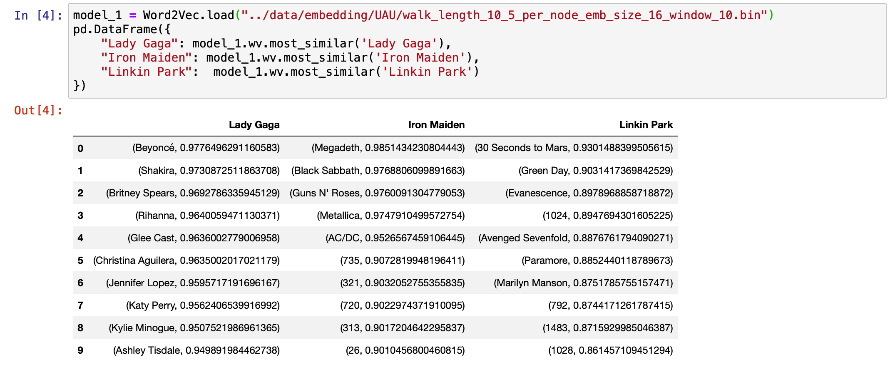
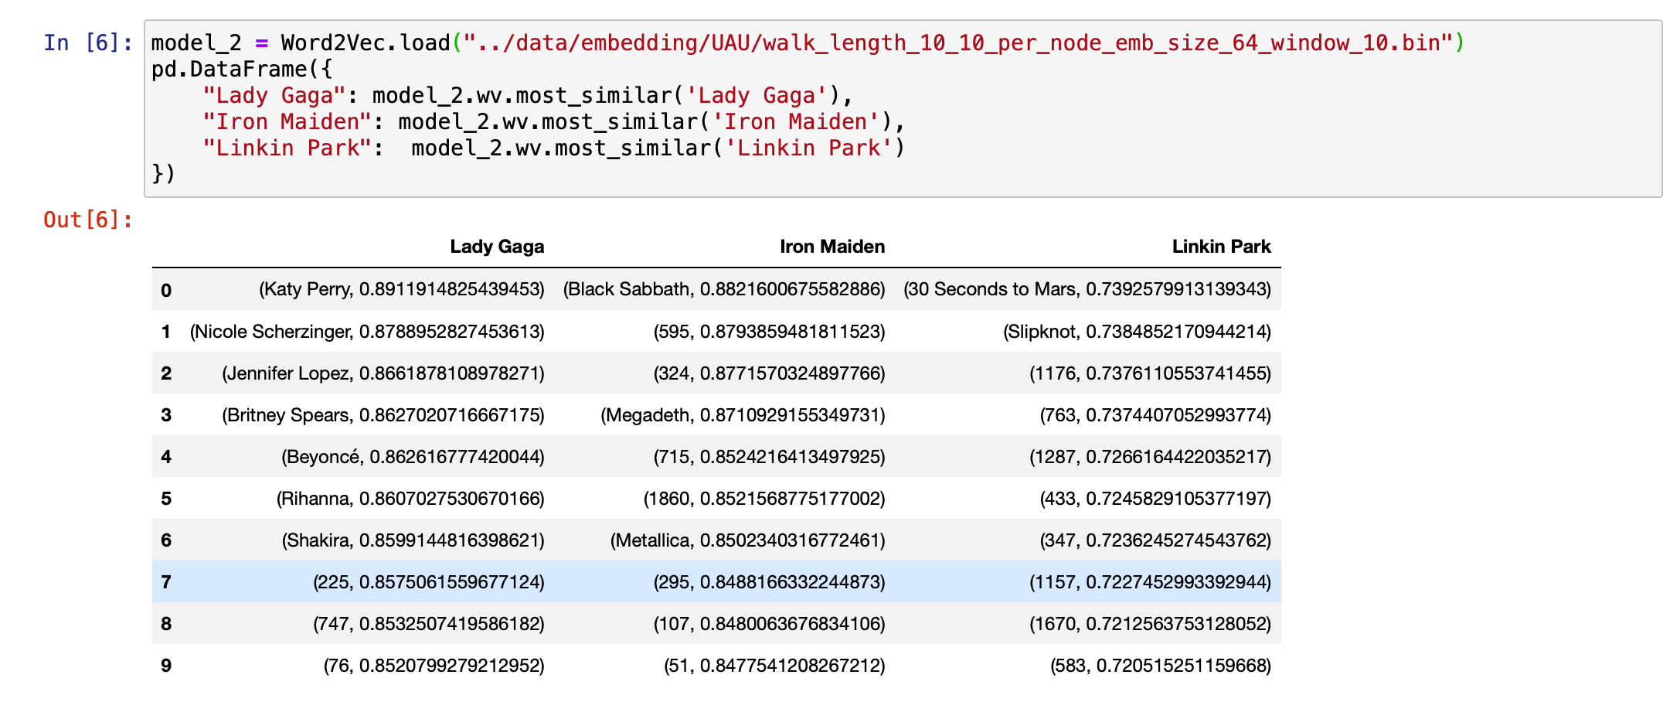
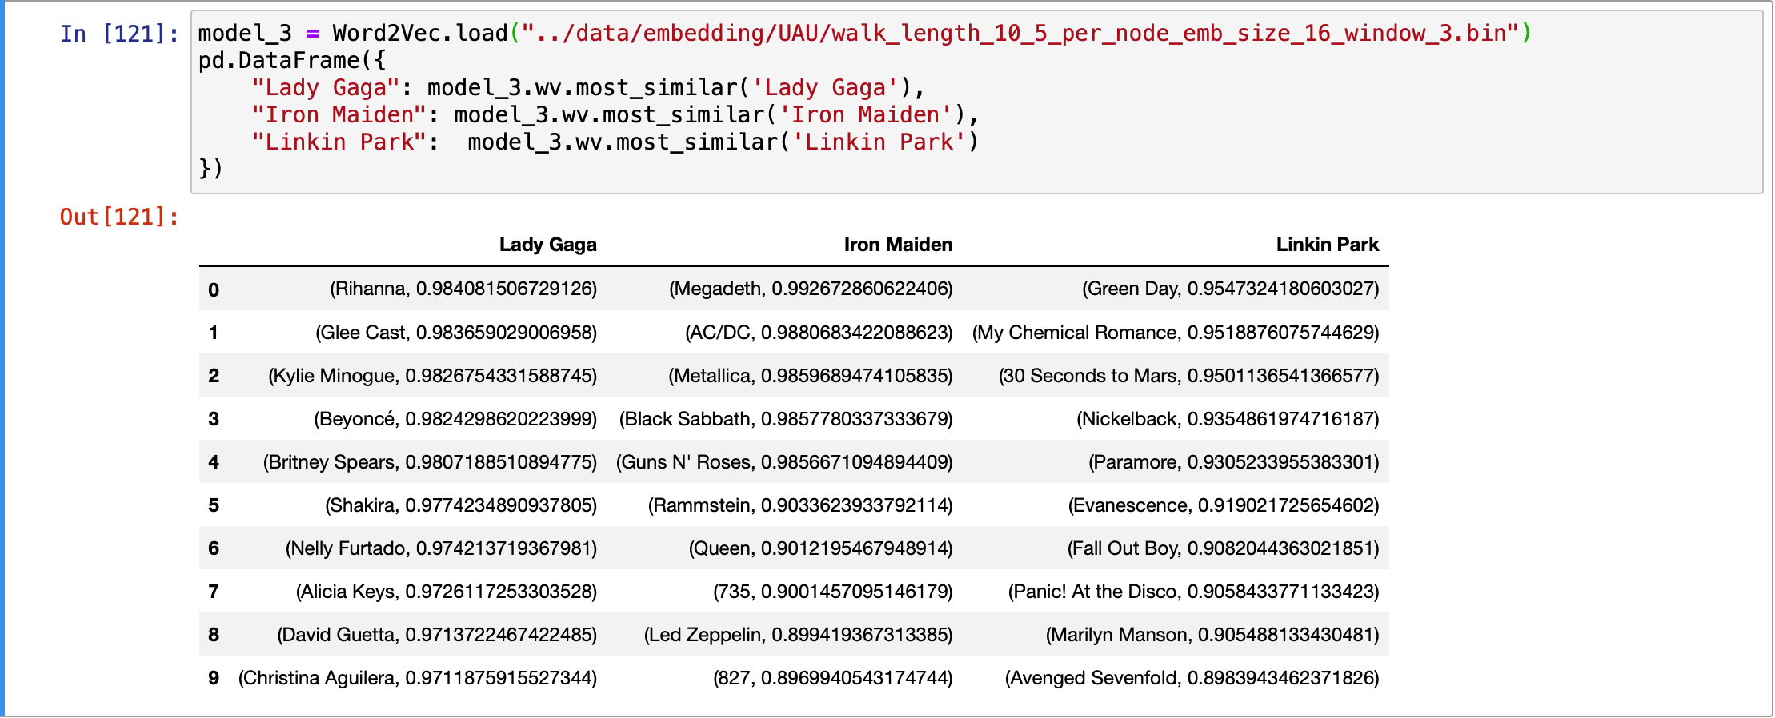
Similarity Search – Cosine Similarity

Slide 9
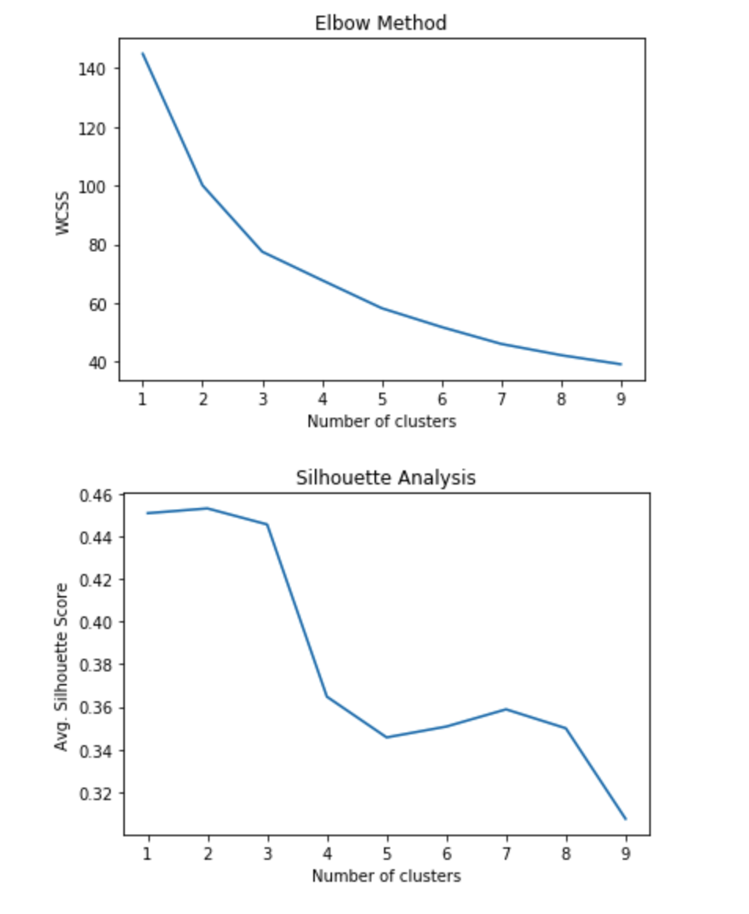
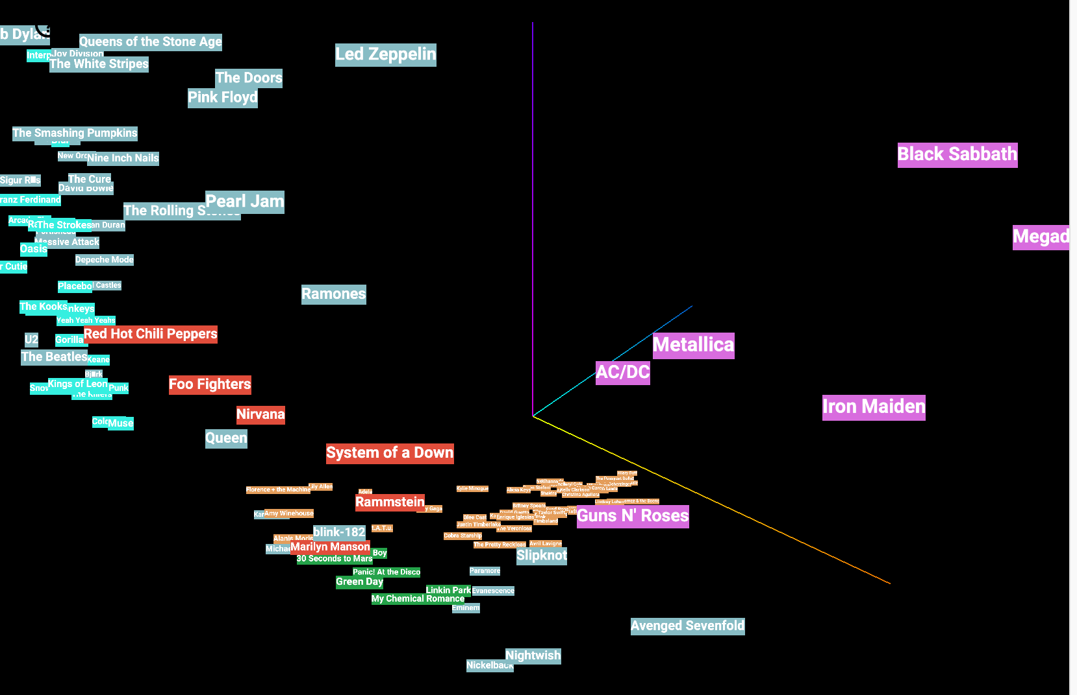
Clustering –
Use clustering algorithms to get meaningful clusters of artist
Kmeans – Even sized clusters – number of clusters
DBSCAN – Uneven Clusters – neighborhood size
Kmeans does not work well
No ground truth to evaluate performance – have to visually inspect clustering results
TensorBoard Embedding projector to visualize embeddings in lower dimensional space (2D/3D)
PCA
TSNE
DBSCAN works better at finding niche genres
Artists with similar music are close
http://projector.tensorflow.org

Slide 10
Conclusion and Future Work –
Network Embedding is very powerful and it works!!
In absence of ground truth it is difficult to find best hyperparameters and test for parameter sensitivity
Compare results with Node2vec, Deepwalk
Augment embeddings to gauge affect of metadata on prediction performance
Look at recent data of user music preference and see how key players have changed.
Application – averaging embeddings of historical user preference to create ‘taste vector’ and recommend Artists/Songs
GitHub –
https://github.com/arunavsk/Network-Science-I606
Image courtesy - Google

Slide 11
Thank You

